Slide 1
ISTM 637: Data Warehousing
Arun Sen
Department of Information & Operations Mgmt.
Mays Business School
Texas A&M University

Slide 2
SQL Server Fundamentals
SQL Server : T-SQL

Slide 3
SQL -- Historical Perspective
For SQL Server …
SSIS Tool, Analysis Services Tool, Reporting Services Tool, etc. …
Database Programming Language (DBPL)
Programming Languages (Java, VB, C, C++, …)
OLAP
SQL Server SQL (Transact-SQL) | Oracle 10G SQL (PL-SQL) | DB2 SQL …
ACCESS (SQL) …
OLTP
SQL Language
Relational Algebra (invented by Ted Codd in 1973)
Purely, from Tools perspective
8/21/2023
CPYRIGHTED BY ARUN SEN, TAMU

Slide 4
Important Pieces in SQL Server
Five Systems Databases
  Master DB (contains information about the server’s databases)
  Model DB (the template database from which new databases are created)
  Msdb DB (maintains a list of activities, such as backups and jobs, and tracks which database backup goes with which user database; schedule a stored procedure, etc.)
  Tempdb (used for adhoc tables by all users, batches, stored procedures and SQL Server engine)
  Reference DB (hidden database serves to make service pack upgrading easier)
8/21/2023
CPYRIGHTED BY ARUN SEN, TAMU

Slide 5
Important Pieces in SQL Server
2. Several Sample Databases
  AdventureWorks
  AdventureWorksDW
8/21/2023
CPYRIGHTED BY ARUN SEN, TAMU

Slide 6
Important Pieces in SQL Server
3. Tools
  The SQL Server Configuration Manager (mainly for Admin)
  The SQL Server Management Studio (we need for the class)
  Transact-SQL (or T-SQL) (we need for the class)
  The Bulk Copy Program (bcp) (old program for copying in bulk; it is a command-line program for moving formatted data in and out)
  SQL Server Profiler (it is a real-time tracing tool – for advanced users)
  SQL Server Integration Services (SSIS) (formerly known as Data Transformation Services (DTS)) (we need for the class)
  7. SQL Server Reporting Services (we need for the class)
  8. SQL Server Analysis Services (we need for the class)
8/21/2023
CPYRIGHTED BY ARUN SEN, TAMU

Slide 7
The SQL Server Management Studio
1. Things you can do --
  create, edit, and delete databases and database objects
  create, edit, and delete DTS packages
  manage scheduled tasks such backups and execution of SSIS package runs
  display current activity, such as who is logged on, what objects are locked, …
  manage configuration settings for the serrver
  initiate and manage the database mail service
  and other administrative things….
Always use SQL Server authentication to log in
8/21/2023
CPYRIGHTED BY ARUN SEN, TAMU

Slide 8
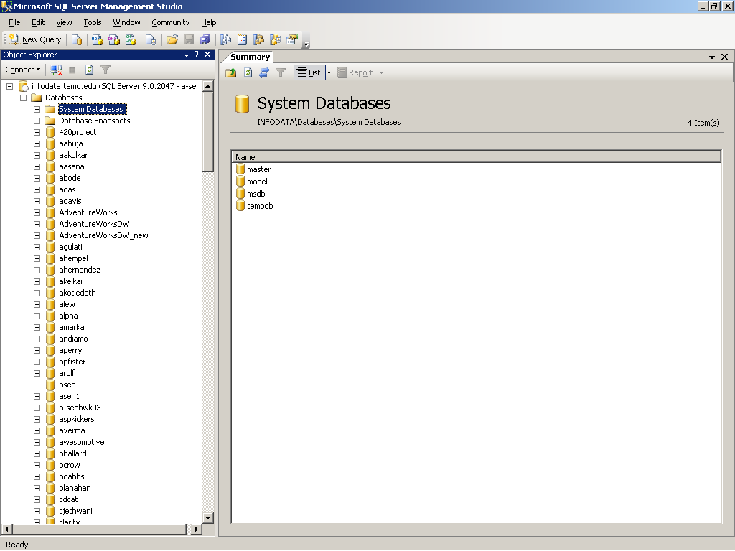
The SQL Server Management Studio
Summary window
8/21/2023
CPYRIGHTED BY ARUN SEN, TAMU

Slide 9
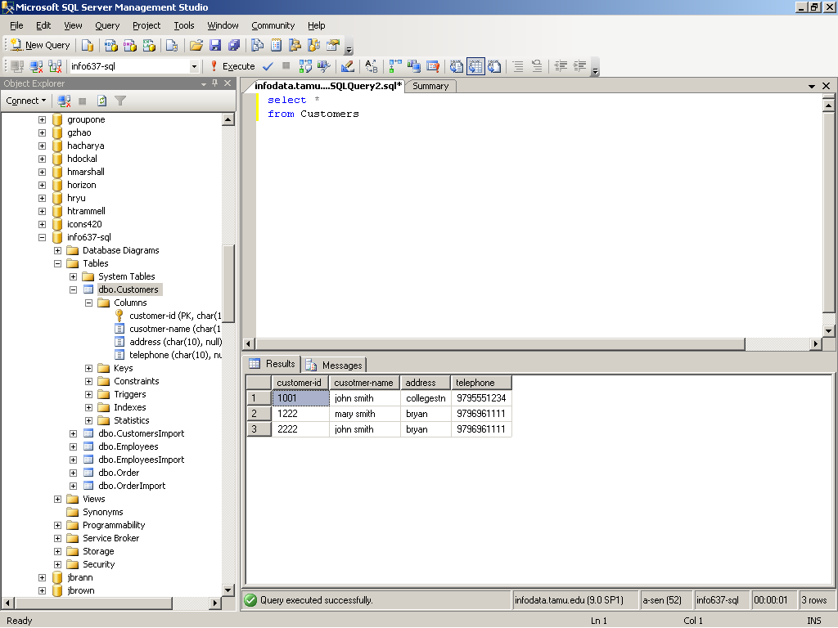
The SQL Server Management Studio
Click this to create a New query
Query Window – see the tab
Results Window – comes from the Window tab
8/21/2023
CPYRIGHTED BY ARUN SEN, TAMU

Slide 10
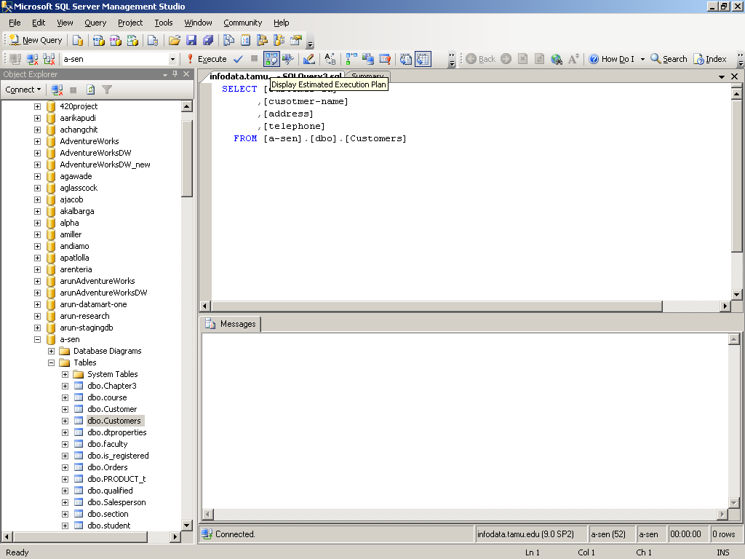
The SQL Server Management Studio
8/21/2023
CPYRIGHTED BY ARUN SEN, TAMU

Slide 11
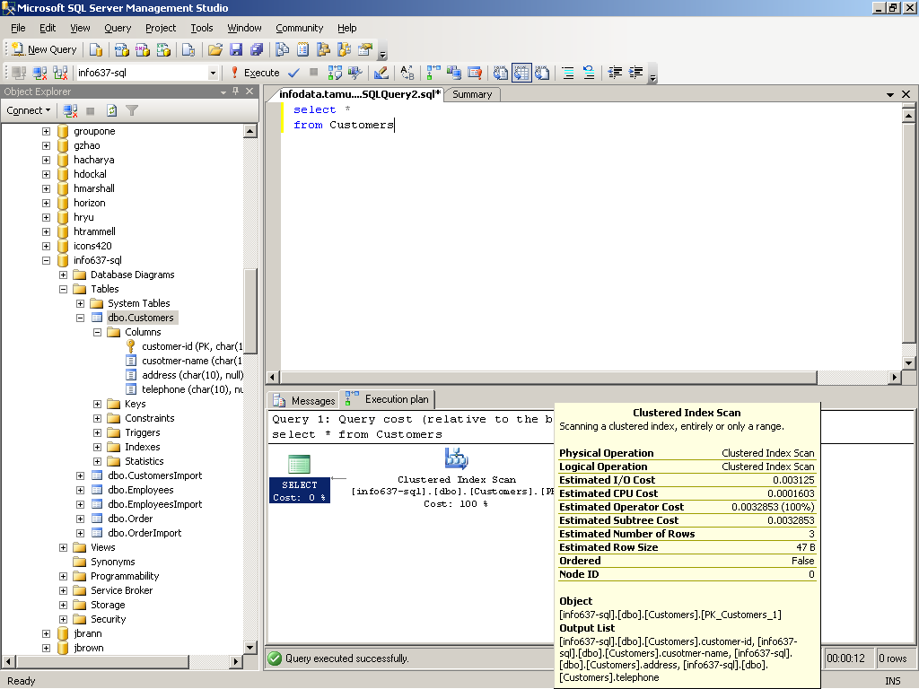
The SQL Server Management Studio
Display Estimated Execution Plan
Click the plan to see
8/21/2023
CPYRIGHTED BY ARUN SEN, TAMU

Slide 12
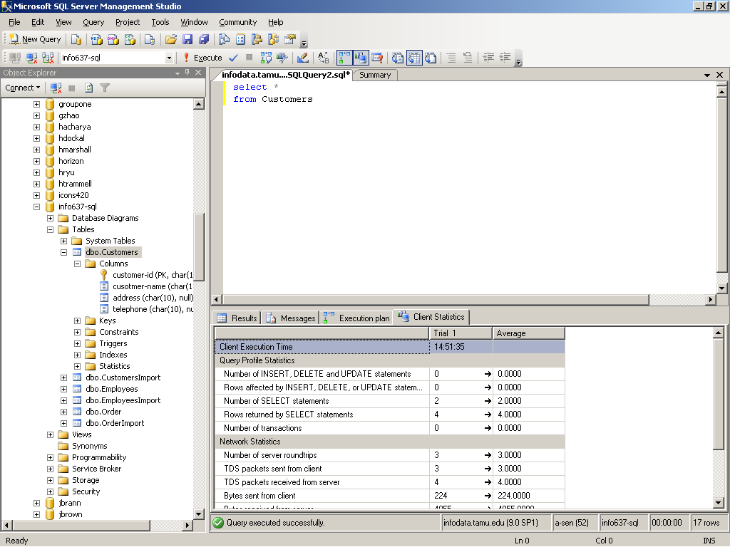
The SQL Server Management Studio
Click the client statistics tabe before Execution
8/21/2023
CPYRIGHTED BY ARUN SEN, TAMU

Slide 13
SQL Server Integration Services
1. Things you can do --
  helps us transfer data from different sources to SQL Server and vice versa
  can also be used to transfer data from Oracle to Excel. Or even Sybase to DB2.
  transfer can be controlled based upon transformation rules.
8/21/2023
CPYRIGHTED BY ARUN SEN, TAMU

Slide 14
The Query Analyzer
1. Things you can do --
  tool for interactive sessions with a given SQL Server
  here, you can execute statements using Transact-SQL
  T-SQL is a dialect of SQL and is SQL-92 compliant
8/21/2023
CPYRIGHTED BY ARUN SEN, TAMU

Slide 15
Bulk Copy Program
1. Things you can do --
  bcp is a command line program that’s sole purpose in life is to move formatted data in and out of SQL Server in bulk
  it is cryptic and compact.
  SSIS has replaced bcp
8/21/2023
CPYRIGHTED BY ARUN SEN, TAMU

Slide 16
Fundamentals of T-SQL
8/21/2023
CPYRIGHTED BY ARUN SEN, TAMU

Slide 17
Fundamentals of T-SQL
Fundamentals of T-SQL
  Create/Alter Tables and Relationships
  Insert/Delete/Update Tables
  Retrievals (single tables; multiple tables)
  Scripts
  Stored Procedures
  Triggers
  Views
8/21/2023
CPYRIGHTED BY ARUN SEN, TAMU

Slide 18
Fundamentals of T-SQL
1. Creating Databases
  Object names
    [Servername, [Databasename, [Ownername,]]] Objectname
    You must provide an object name whenever you are performing an operation on that object and rest are optional
  Ownership
    whoever creates the database is considered to be the “database owner”
  Database Name
    It is needed in case you want to access data other than the default or current database
8/21/2023
CPYRIGHTED BY ARUN SEN, TAMU

Slide 19
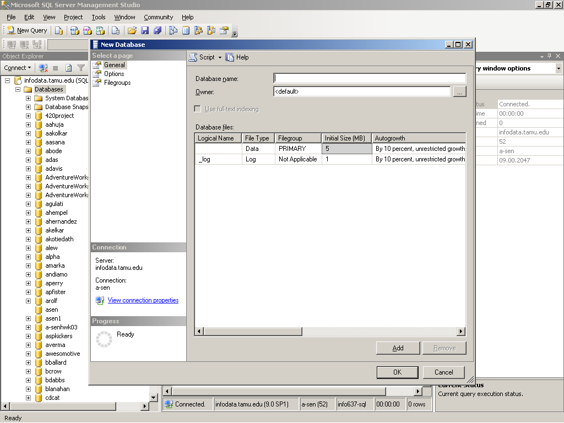
Fundamentals of T-SQL
1. Creating Databases
New DB creation – right-click on Databases
8/21/2023
CPYRIGHTED BY ARUN SEN, TAMU

Slide 20
Fundamentals of T-SQL
1. Creating and Altering Tables (using CLI- Command Line Interface)
  There are numerous commands for creating and altering tables in the database. Some examples are –
    create database <database name> [on ….
    create table customers (customerNo int IDENTITY NOT NULL,
    address1 ….)
    alter database <database name> …. for changing the DB
    alter table <table_name> …. for changing the table
  We can do all these also using Query Analyzer
8/21/2023
CPYRIGHTED BY ARUN SEN, TAMU

Slide 21
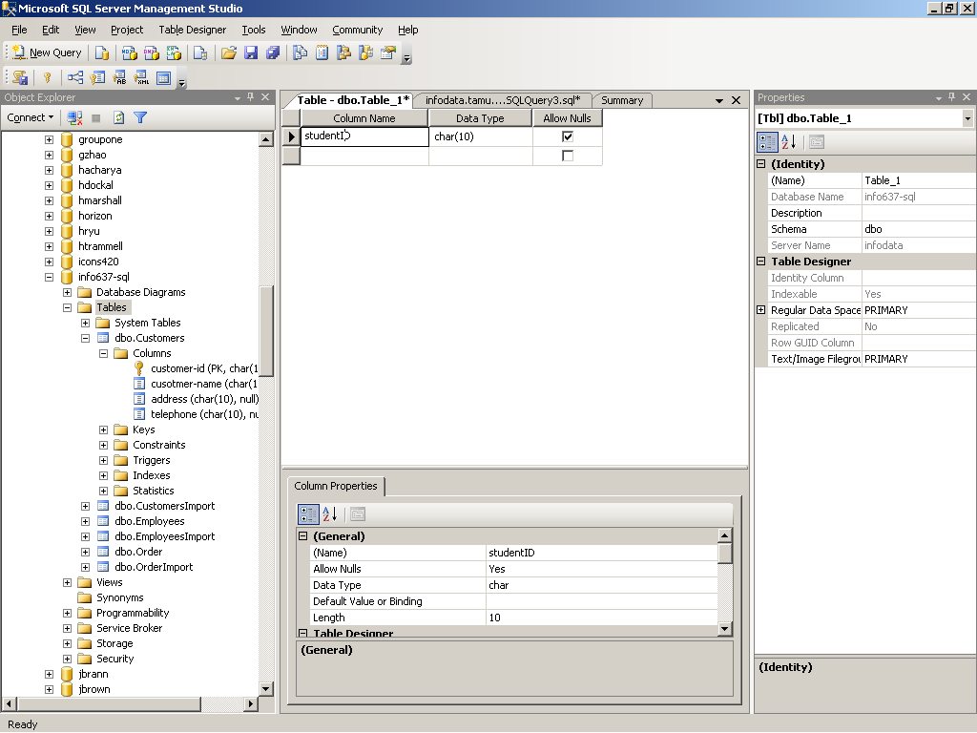
Fundamentals of T-SQL
1. Creating and Altering Tables (using GUI)
New table creation – right-click on Tables
8/21/2023
CPYRIGHTED BY ARUN SEN, TAMU

Slide 22
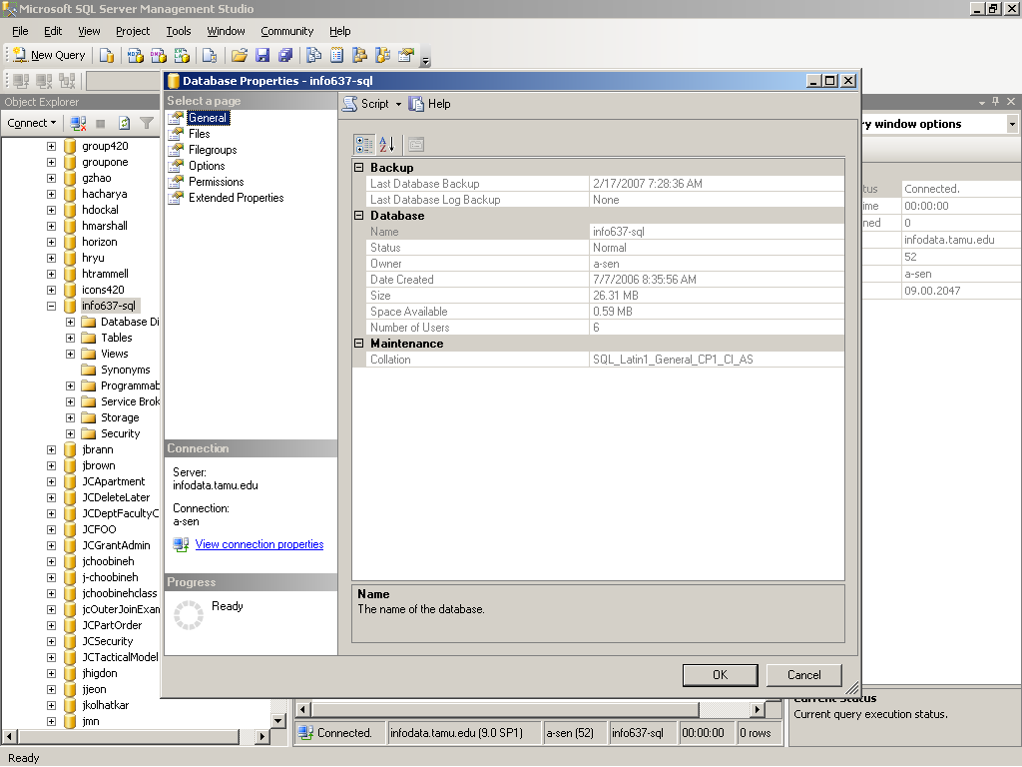
Fundamentals of T-SQL
1. Creating and Altering Tables (using GUI)
Right-click on an existing DB and click Properties
8/21/2023
CPYRIGHTED BY ARUN SEN, TAMU

Slide 23
Fundamentals of T-SQL
1. Creating and Altering Tables (Add constraints)
  Domain constraints (for each attribute/column)
  Entity constraints (for each row/tuple)
  Referential integrity constraints (when value of an attribute of a table matches with the value of an attribute of another Relation)
  Key constraints (PK, FK, Self-referencing [employee is a manager], Unique, “check”, “default”, ….)
8/21/2023
CPYRIGHTED BY ARUN SEN, TAMU

Slide 24
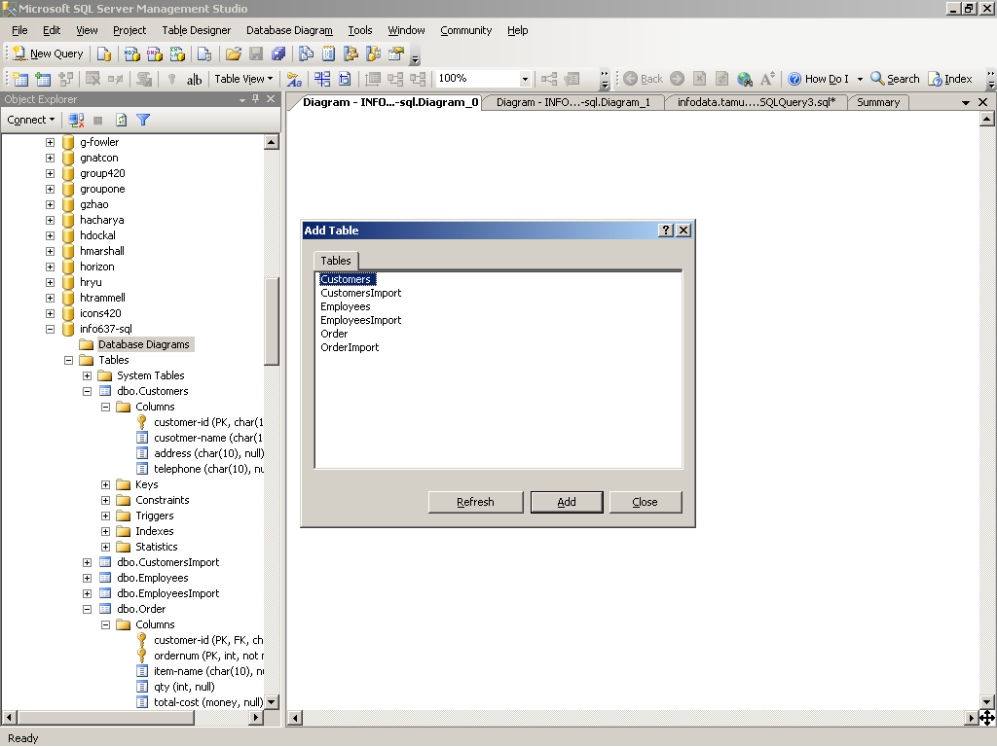
Fundamentals of T-SQL
1. Creating and Altering Tables (Add constraints)
Right click Database Diagram to create referential integrity constraint
8/21/2023
CPYRIGHTED BY ARUN SEN, TAMU

Slide 25
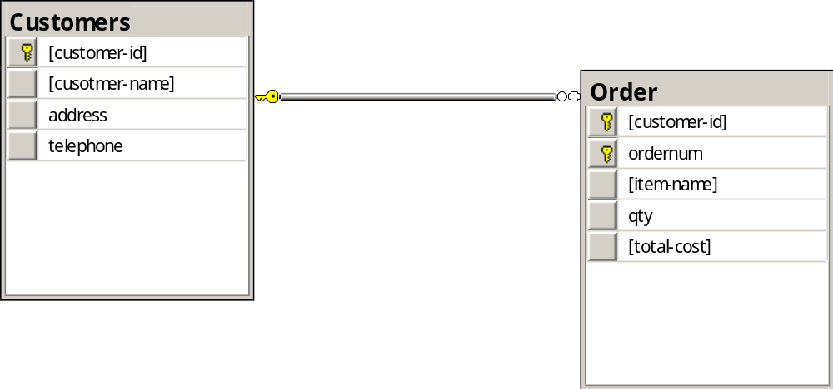
Fundamentals of T-SQL
1. Creating and Altering Tables (Add Relationship)
Use right-click on the Diagram and choose New Database Diagram OR click and drag tables
8/21/2023
CPYRIGHTED BY ARUN SEN, TAMU

Slide 26
Fundamentals of T-SQL
2. INSERT, DELETE AND UPDATE
  You can use
      INSERT [INTO] <table> [(column_list)] VALUES (data_values)
  You can also use
INSERT INTO <tablename> [<column list>] <SELECT stmt>
  Delete statement looks as
    DELETE <table_name> [WHERE <search condition>]
8/21/2023
CPYRIGHTED BY ARUN SEN, TAMU

Slide 27
Fundamentals of T-SQL
2. INSERT, DELETE AND UPDATE
  Update looks like
    UPDATE <table name> SET <column> = <value> [, <column> = <value>] [FROM <source table (s)>] [WHERE <restrictive condition>]
  We can also use Query Analyzer
8/21/2023
CPYRIGHTED BY ARUN SEN, TAMU

Slide 28
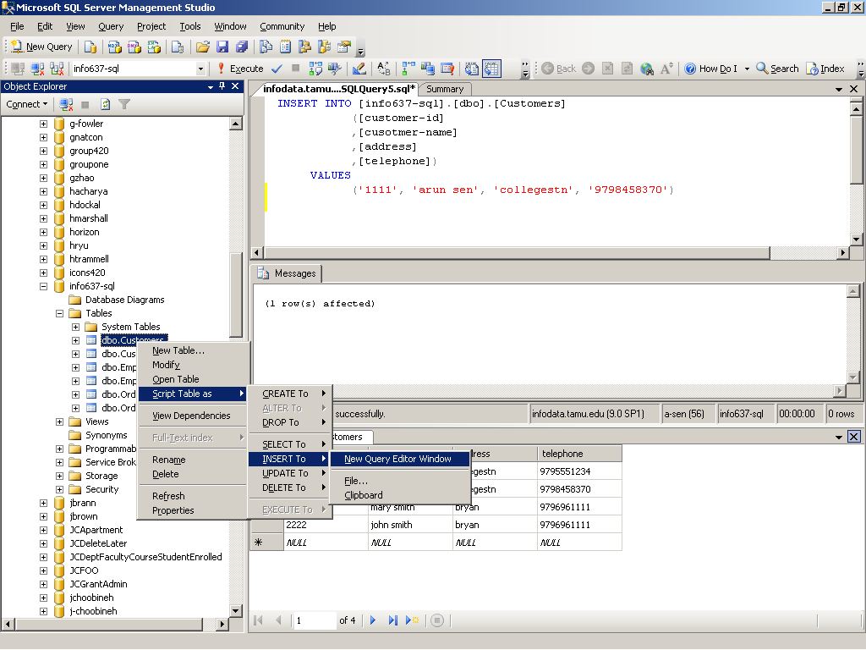
Fundamentals of T-SQL
2. INSERT, DELETE AND UPDATE Table
8/21/2023
CPYRIGHTED BY ARUN SEN, TAMU

Slide 29
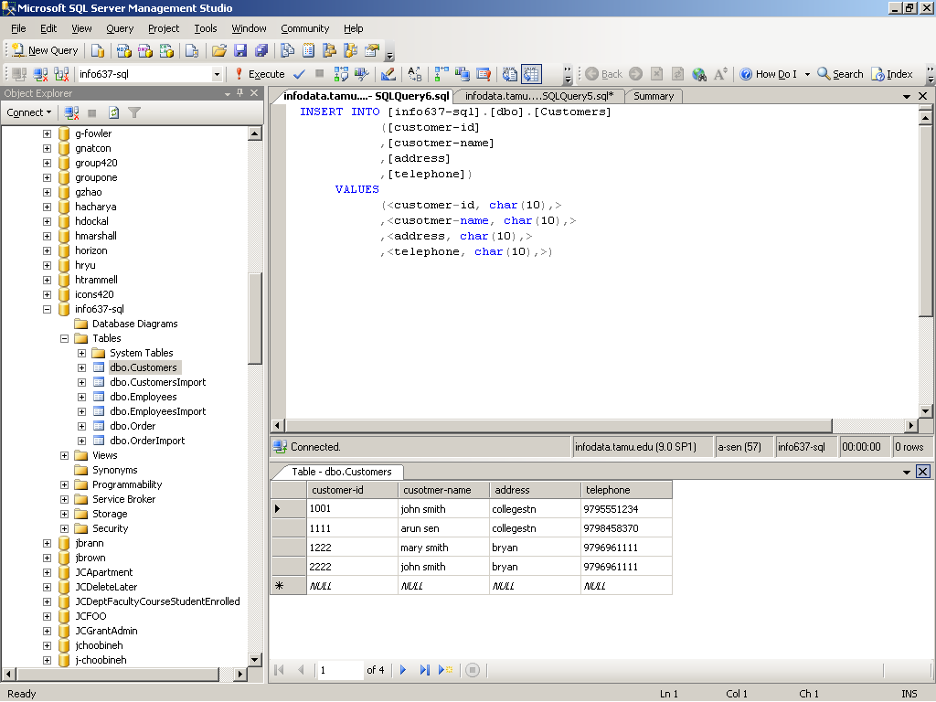
Fundamentals of T-SQL
2. INSERT, DELETE AND UPDATE Table
8/21/2023
CPYRIGHTED BY ARUN SEN, TAMU

Slide 30
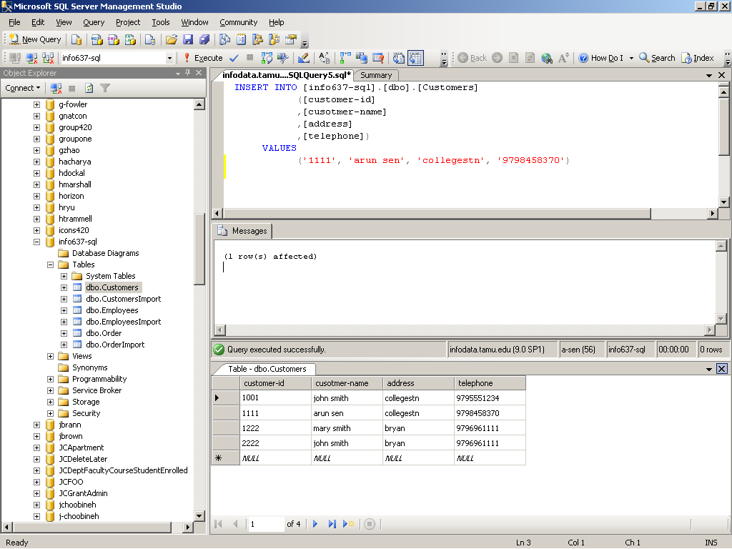
Fundamentals of T-SQL
2. INSERT, DELETE AND UPDATE Table
8/21/2023
CPYRIGHTED BY ARUN SEN, TAMU

Slide 31
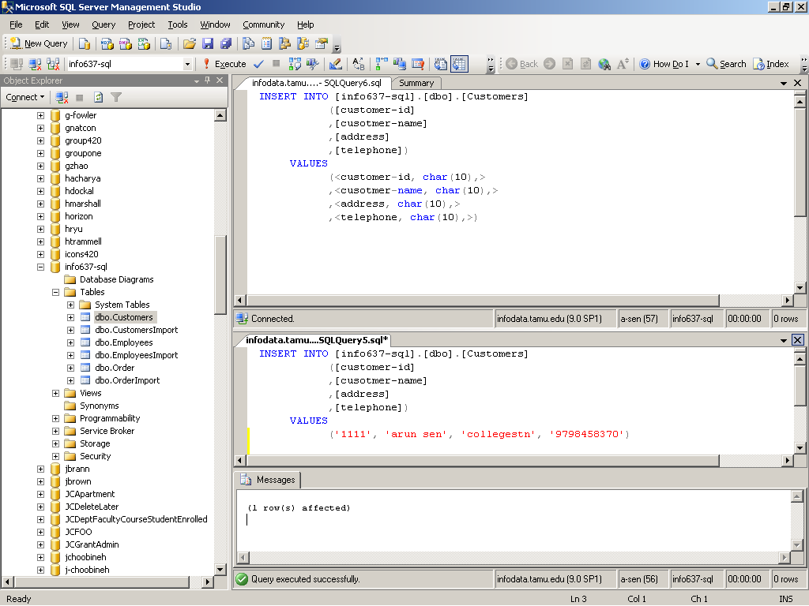
Fundamentals of T-SQL
2. INSERT, DELETE AND UPDATE Table
8/21/2023
CPYRIGHTED BY ARUN SEN, TAMU

Slide 32
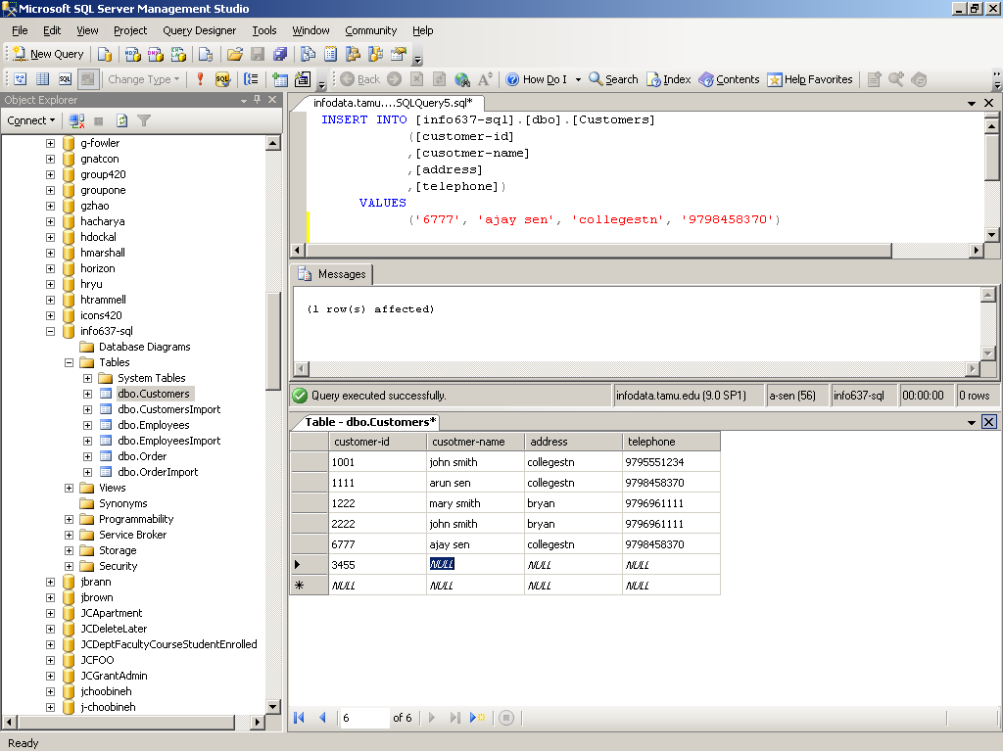
Fundamentals of T-SQL
2. INSERT, DELETE AND UPDATE
Click this to insert
8/21/2023
CPYRIGHTED BY ARUN SEN, TAMU

Slide 33
Fundamentals of T-SQL
3. QUERIES (using Quary Analyzer)
  SELECT command
    SELECT <column_list>
    [FROM <source tables>] [WHERE <restrictive condition>]
    [GROUP BY ….
    [ORDER BY …
    [FOR XML …
  Aggregates (AVG, MIN/MAX, COUNT, ….)
8/21/2023
CPYRIGHTED BY ARUN SEN, TAMU

Slide 34
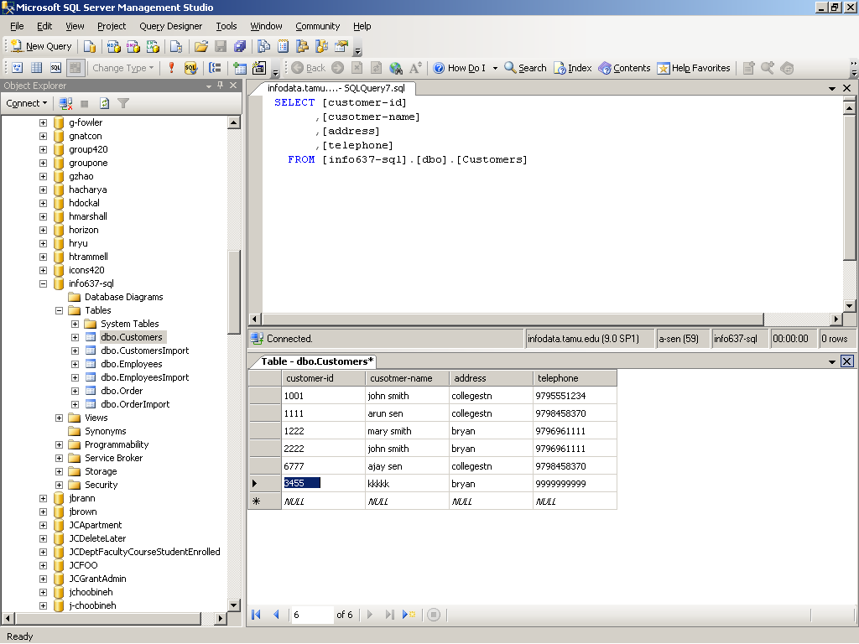
Fundamentals of T-SQL
8/21/2023
CPYRIGHTED BY ARUN SEN, TAMU

Slide 35
Fundamentals of T-SQL
QUERIES (using Query Analyzer)
  JOIN command
    INNER JOIN (match records only returns the records where there are matches)
    OUTER JOIN
    FULL JOIN
    CROSS JOIN
  Union command
8/21/2023
CPYRIGHTED BY ARUN SEN, TAMU

Slide 36
Fundamentals of T-SQL
4. Scripts
  A script is technically is not a script until you store it in a file where it can be pulled up and reused.
  Scripts are stored as text files
  SQL Server Management Studio provides many tools to help you with your script writing
  Scripts are currently written in Query Analyzer
8/21/2023
CPYRIGHTED BY ARUN SEN, TAMU

Slide 37
Fundamentals of T-SQL
A simple text file of SQL commands
Offers a method to recreate a set of SQL instruction many times in many places
  Data Definitions
  Queries
You may not have realized it or not, you have already been writing SQL-scripts. Every CREATE statement, every SELECT is all or part of a script.
A script technically is not a script until you store it in a file where it can be pulled and reused. SQL scripts are stored as text file. You can use Notepad or SQL editing tool or, better yet, Query Analyzer.
8/21/2023
CPYRIGHTED BY ARUN SEN, TAMU

Slide 38
Fundamentals of T-SQL
To create a script
  Type statements into Query Analyzer
  Choose File | Save from the File menu
To run an existing script
  Choose File | Open form the File menu
  Choose the script file you wish to run from the resulting dialog box
  Run the script
    Query | Run menus
    Green arrow in toolbar
8/21/2023
CPYRIGHTED BY ARUN SEN, TAMU

Slide 39
Fundamentals of T-SQL
use statement
  The use statement sets the current database.
  It is not needed in all scripts, especially if you are building a general-purpose script.
  ➔ Use AdventureWorks
8/21/2023
CPYRIGHTED BY ARUN SEN, TAMU

Slide 40
Fundamentals of T-SQL
Declaring variables
  The DECLARE statement has a pretty simple syntax:
  DECLARE @<variable name> <variable type> [,
  @<variable name> <variable type> [,
  @<variable name> <variable type> ] ]
  You can declare just one variable at a time or several.
  The value of your variable will always be NULL
  ➔ DECLARE @ident int
8/21/2023
CPYRIGHTED BY ARUN SEN, TAMU

Slide 41
Fundamentals of T-SQL
Setting the Value in your Variables
Two ways to change the values of the variables -
  Use SET for simple assignment
    Setting Variables using SET
        SET @totalcost = 10
        SET @totalcost = @unitcost * 1.1
    To assign a value to a variable from a query using SET, you need to use:
        USE ARUN-AdventureWorks
        DECLARE @Test money
        SET @test = (SELECT MAX (UnitPrice) FROM [Order Details])
        SELECT @test
8/21/2023
CPYRIGHTED BY ARUN SEN, TAMU

Slide 42
Fundamentals of T-SQL
Setting the Value in your Variables
  Setting variables using SELECT
    SELECT is usually used to assign variable values when the source of information you are storing in the variable is from the query.
    USE AdventureWorks
    DECLARE @test money
    SELECT @test = MAX (UnitPrice) FROM (Order Details)
    SELECT @test
8/21/2023
CPYRIGHTED BY ARUN SEN, TAMU

Slide 43
Fundamentals of T-SQL
There are many System Functions
  @@IDENTITY returns the last identity value inserted as a result of the last INSERT or SELECT INTO statement. It is set to NULL, if no identity value was generated.
        A good article on @@IDENTITY is in the URL http://www.kamath.com/tutorials/tut007_identity.asp
  @@ERROR returns the error number of the last T-SQL statement executed on the current connection. It is reset with each new statement.
8/21/2023
CPYRIGHTED BY ARUN SEN, TAMU

Slide 44
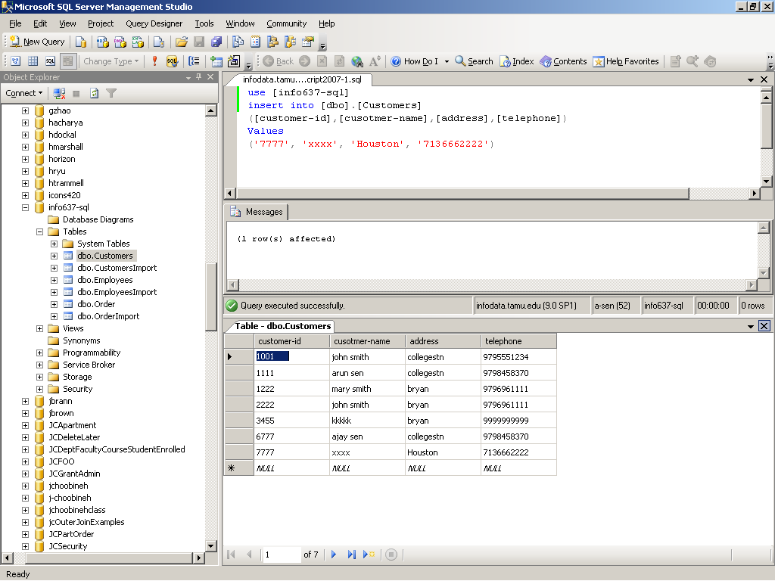
Fundamentals of T-SQL
8/21/2023
CPYRIGHTED BY ARUN SEN, TAMU

Slide 45
Fundamentals of T-SQL
5. Stored Procedures
In SQL Server, there are four types of stored procedure:
  System stored procedures
  User-defined stored procedures
  Temporary stored procedures
  Extended stored procedures
8/21/2023
CPYRIGHTED BY ARUN SEN, TAMU

Slide 46
Fundamentals of T-SQL
  System stored procedures
    These are created automatically in systems databases when you install SQL Server. They are basically a way to interact with system tables.
    There always a system stored procedure for almost any administrative task performed in SQL Server
  Temporary stored procedures
    These are stored procedures created by users and stored in the tempdb database. They are dropped when the connection that creates them is finished.
  Extended stored procedures
    These are DLL programs written in C++ and then adding it to SQL Server as an extended procedure …
8/21/2023
CPYRIGHTED BY ARUN SEN, TAMU

Slide 47
Fundamentals of T-SQL
User-defined stored procedures
  These are used to implement the business logic
  These procedures are created using CREATE PROCEDURE statement, and then SQL Server stores them in the current database.
  Stored procedures’ names, like any other object’s name, must be unique within the database and unique to the user who creates them (the owner). Hence, in a certain database, it is possible that two stored procedures exist with the same name but with different owners.
  Any stored procedure that is created in the database with the sp_ prefix – for example, sp_myprocedure – can be accessed from any other database. (When executing such a stored procedure, SQL Sever looks for it, first in the current database, and then if it is not found in the current database, then it looks for it in the master database.)
8/21/2023
CPYRIGHTED BY ARUN SEN, TAMU

Slide 48
Fundamentals of T-SQL
Also known as “sproc”
It is really just something of a script
Only programming language allowed is T-SQL
So, it is a collection of SQL statements
Can accept variables
Can be used for security
  Users can be granted right to use stored procedure, even if they do not have access to underlying tables
Can only be created in the current database
8/21/2023
CPYRIGHTED BY ARUN SEN, TAMU

Slide 49
Basic Syntax
Fundamentals of T-SQL
CREATE PROCEDURE | PROC <sproc name>
[<parameter name> <data type> [VARYING] [= <default value>] [OUTPUT] [,
<parameter name> <data type> [VARYING] [= <default value>] [OUTPUT] [,
…
…
] ]
[WITH
RECOMPILE | ENCRYPTION | RECOMPILE, ENCRYPTION]
[FOR REPLICATION]
AS
<code>
GO
8/21/2023
CPYRIGHTED BY ARUN SEN, TAMU

Slide 50
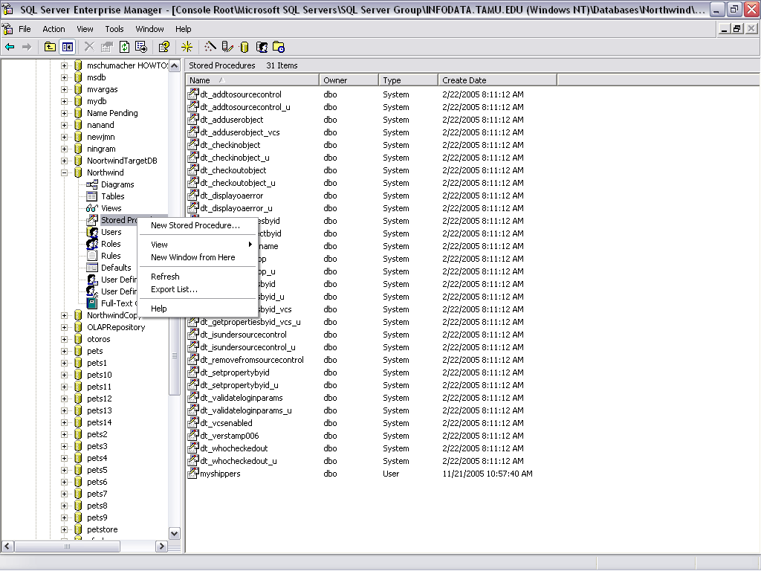
Creating Stored Procedures – Retrieval (EM)
8/21/2023
CPYRIGHTED BY ARUN SEN, TAMU
Notes:
You can create stored procedures in Enterprise Manager, but it’s essentially the same as in Query Analyzer.

Slide 51
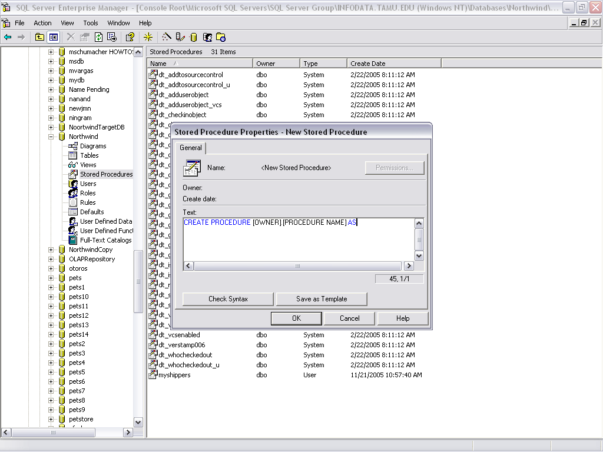
Creating Stored Procedures – Retrieval (EM)
8/21/2023
CPYRIGHTED BY ARUN SEN, TAMU
Notes:
You can create stored procedures in Enterprise Manager, but it’s essentially the same as in Query Analyzer.

Slide 52
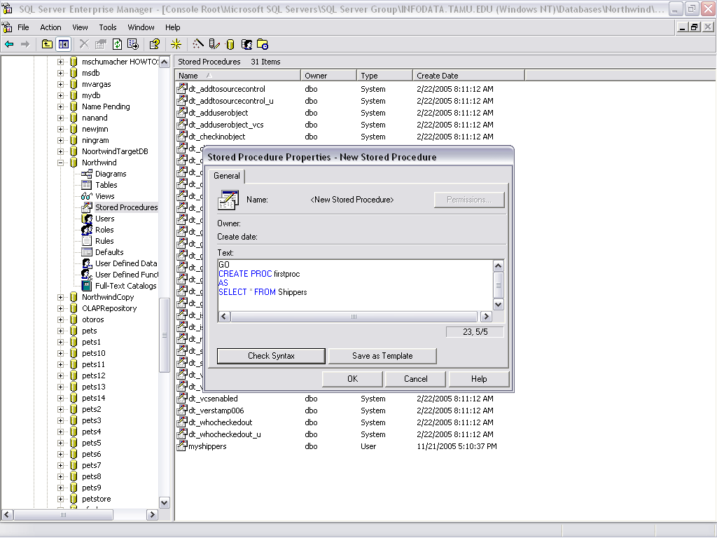
Creating Stored Procedures – Retrieval (EM)
8/21/2023
CPYRIGHTED BY ARUN SEN, TAMU
Notes:
You can create stored procedures in Enterprise Manager, but it’s essentially the same as in Query Analyzer.

Slide 53
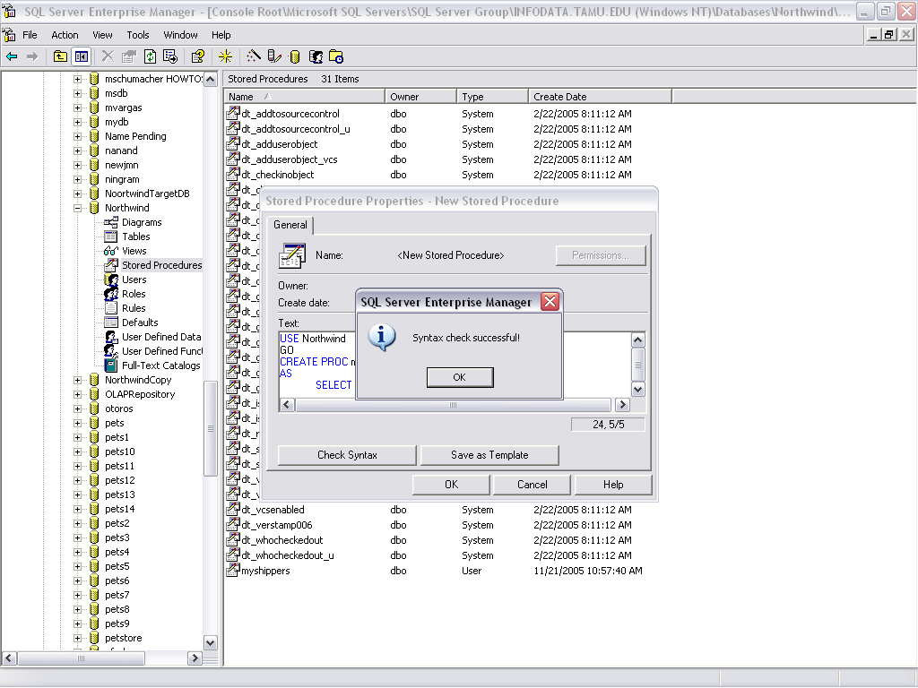
Creating Stored Procedures – Retrieval (EM)
8/21/2023
CPYRIGHTED BY ARUN SEN, TAMU
Notes:
You can create stored procedures in Enterprise Manager, but it’s essentially the same as in Query Analyzer.

Slide 54
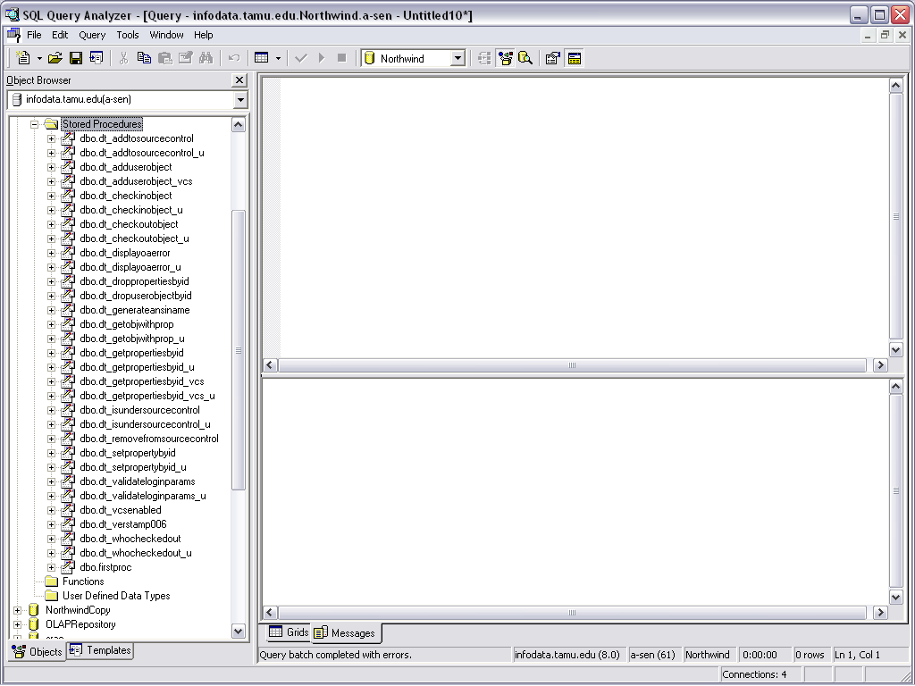
Creating Stored Procedures – Retrieval (EM)
8/21/2023
CPYRIGHTED BY ARUN SEN, TAMU
Notes:
You can create stored procedures in Enterprise Manager, but it’s essentially the same as in Query Analyzer.

Slide 55
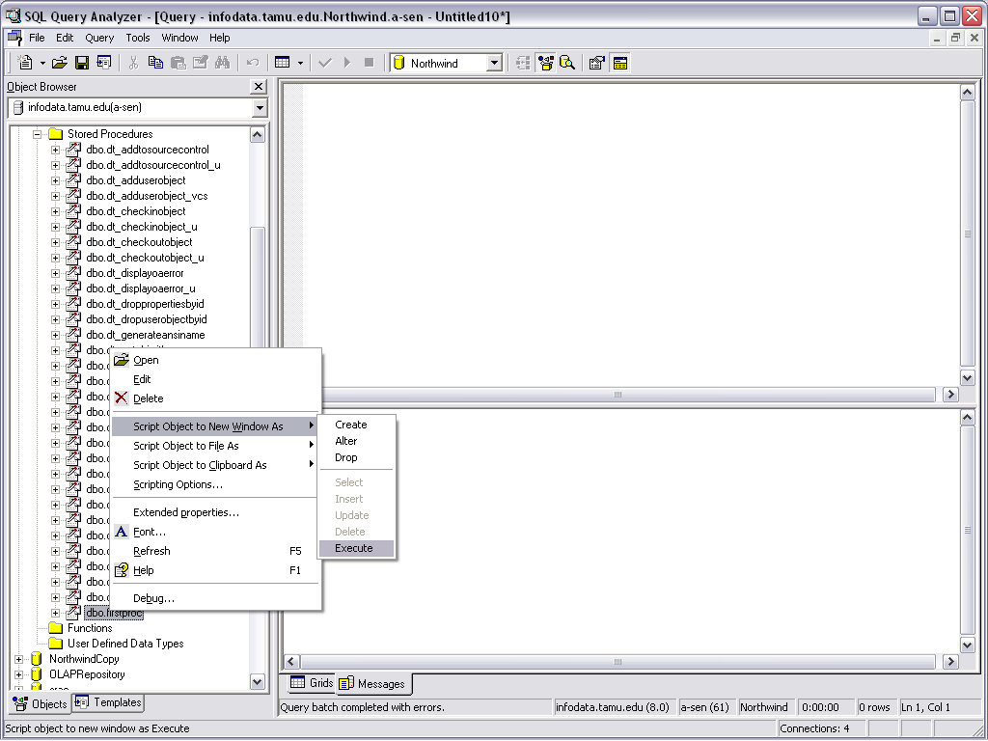
Creating Stored Procedures – Retrieval (EM)
8/21/2023
CPYRIGHTED BY ARUN SEN, TAMU
Notes:
You can create stored procedures in Enterprise Manager, but it’s essentially the same as in Query Analyzer.

Slide 56
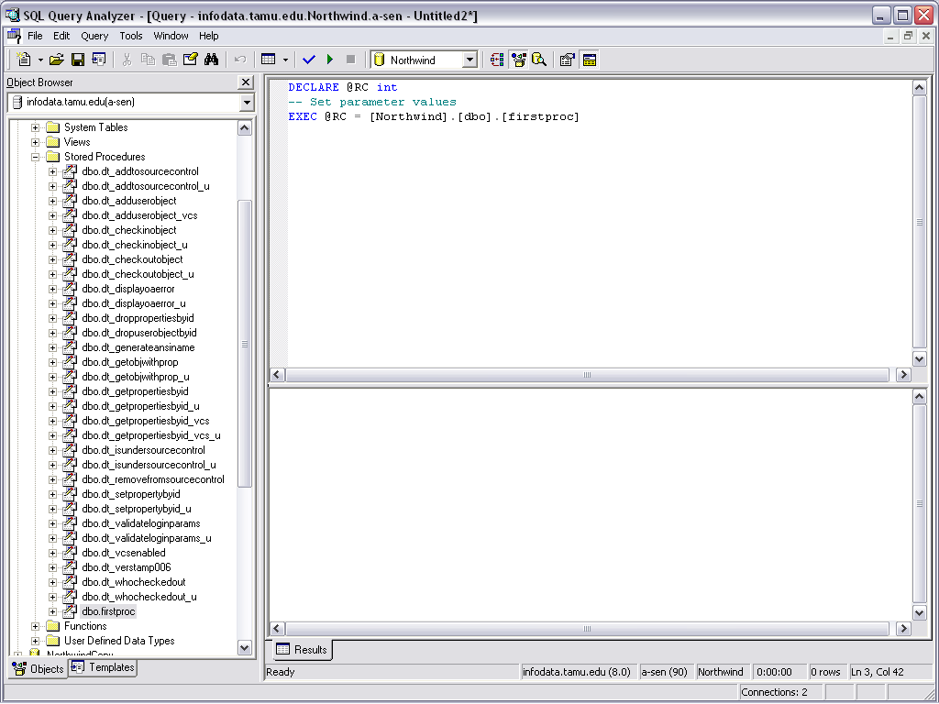
Creating Stored Procedures – Run from QA
8/21/2023
CPYRIGHTED BY ARUN SEN, TAMU
Notes:
You can create stored procedures in Enterprise Manager, but it’s essentially the same as in Query Analyzer.

Slide 57
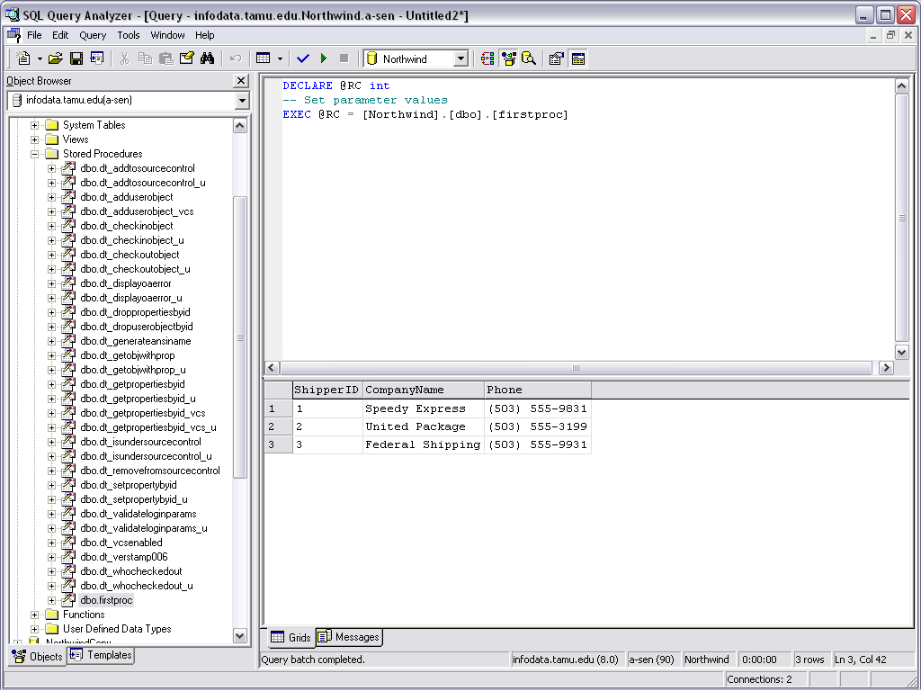
Creating Stored Procedures – Run from QA
8/21/2023
CPYRIGHTED BY ARUN SEN, TAMU
Notes:
You can create stored procedures in Enterprise Manager, but it’s essentially the same as in Query Analyzer.

Slide 58
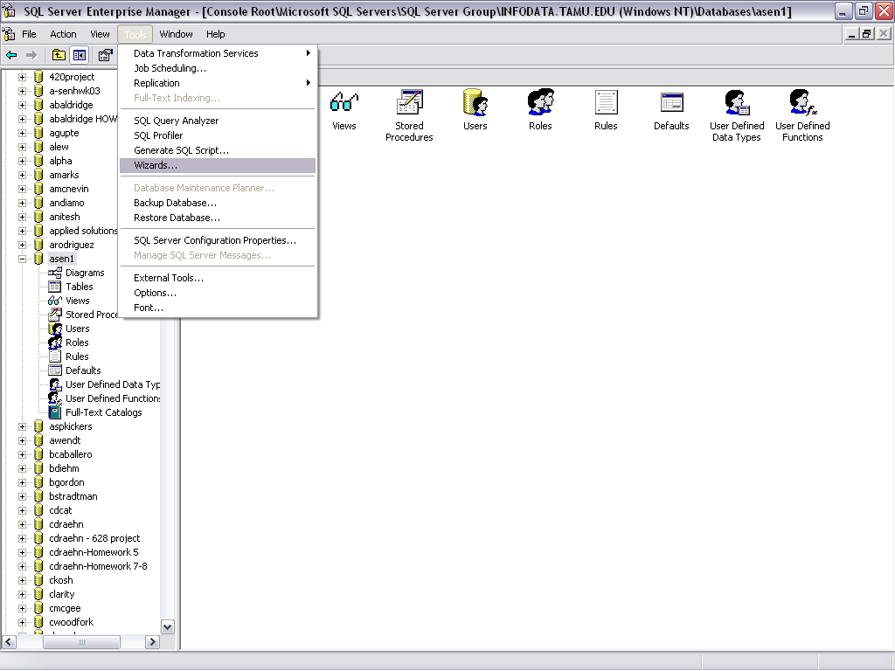
Creating Stored Procedures – Insert EM Wizard
8/21/2023
CPYRIGHTED BY ARUN SEN, TAMU
Notes:
You can create stored procedures in Enterprise Manager, but it’s essentially the same as in Query Analyzer.

Slide 59
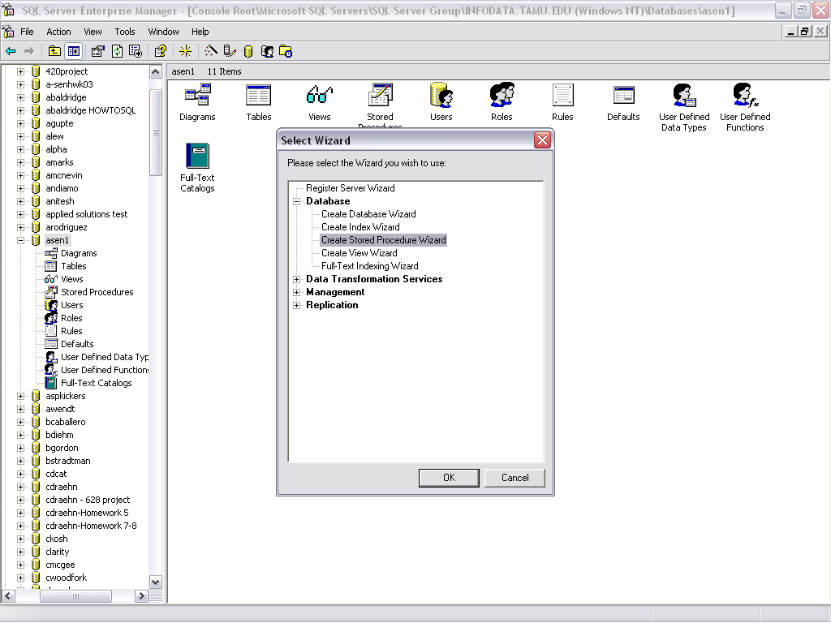
Creating Stored Procedures – Insert EM Wizard
8/21/2023
CPYRIGHTED BY ARUN SEN, TAMU
Notes:
You can create stored procedures in Enterprise Manager, but it’s essentially the same as in Query Analyzer.

Slide 60
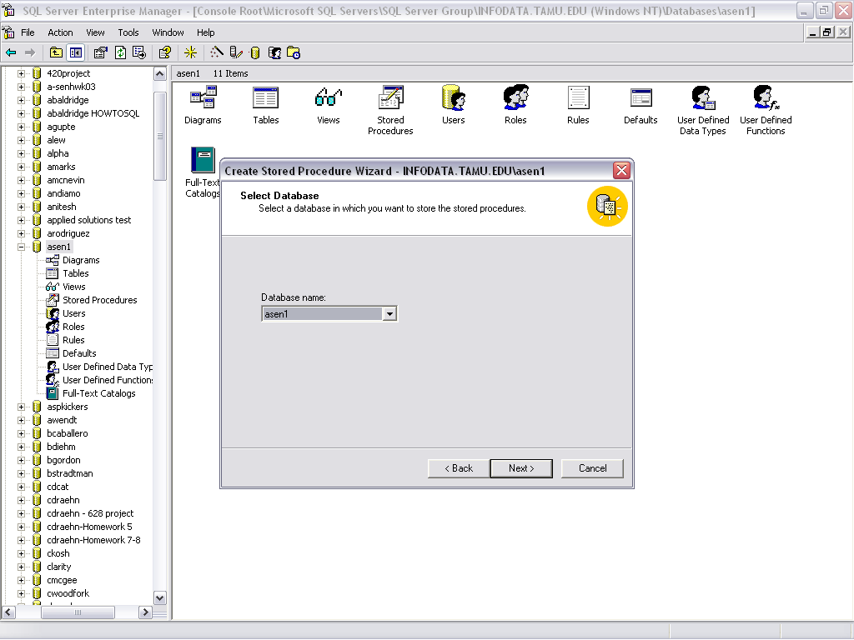
Creating Stored Procedures – Insert EM Wizard
8/21/2023
CPYRIGHTED BY ARUN SEN, TAMU
Notes:
You can create stored procedures in Enterprise Manager, but it’s essentially the same as in Query Analyzer.

Slide 61
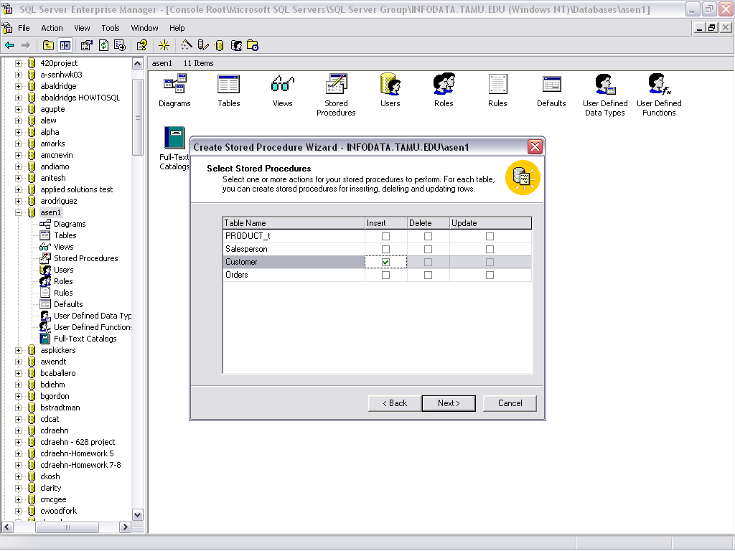
Creating Stored Procedures – Insert EM Wizard
8/21/2023
CPYRIGHTED BY ARUN SEN, TAMU
Notes:
You can create stored procedures in Enterprise Manager, but it’s essentially the same as in Query Analyzer.

Slide 62
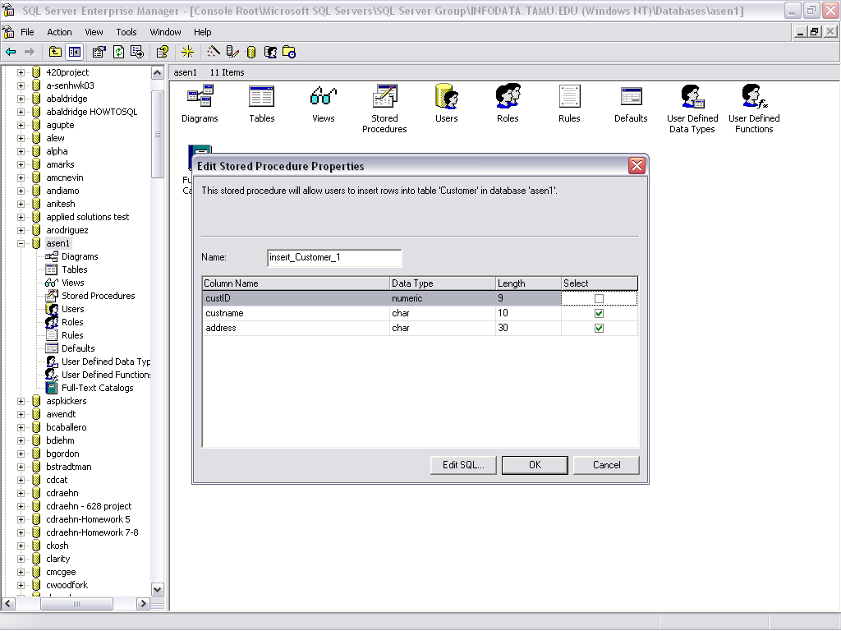
Creating Stored Procedures – Insert EM Wizard
8/21/2023
CPYRIGHTED BY ARUN SEN, TAMU
Notes:
You can create stored procedures in Enterprise Manager, but it’s essentially the same as in Query Analyzer.

Slide 63
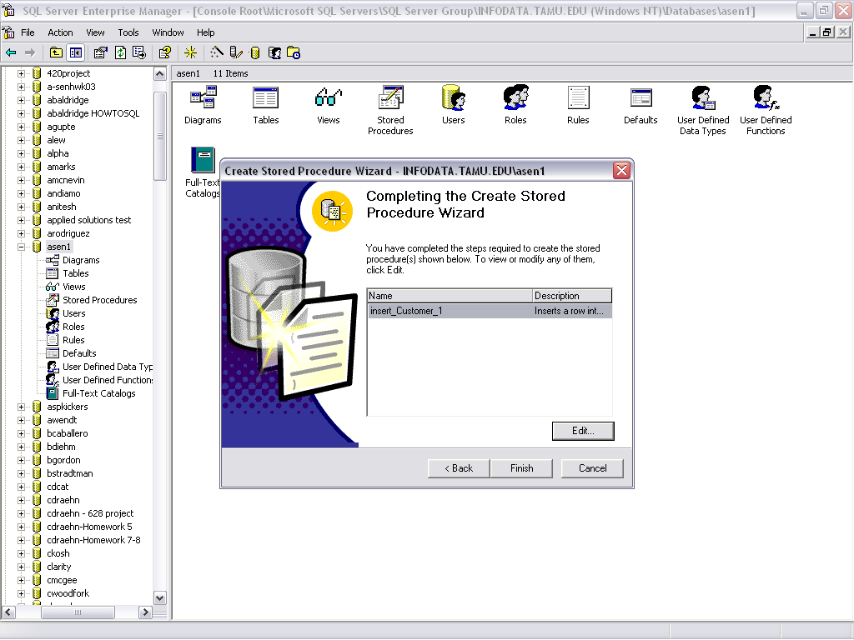
Creating Stored Procedures – Insert EM Wizard
8/21/2023
CPYRIGHTED BY ARUN SEN, TAMU
Notes:
You can create stored procedures in Enterprise Manager, but it’s essentially the same as in Query Analyzer.

Slide 64
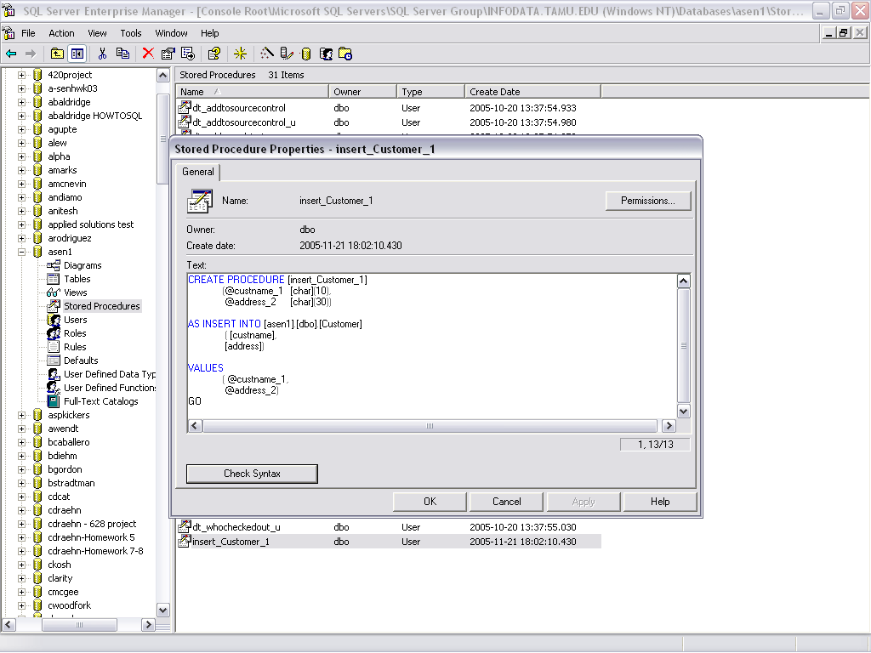
Creating Stored Procedures – Insert EM Wizard
8/21/2023
CPYRIGHTED BY ARUN SEN, TAMU
Notes:
You can create stored procedures in Enterprise Manager, but it’s essentially the same as in Query Analyzer.

Slide 65
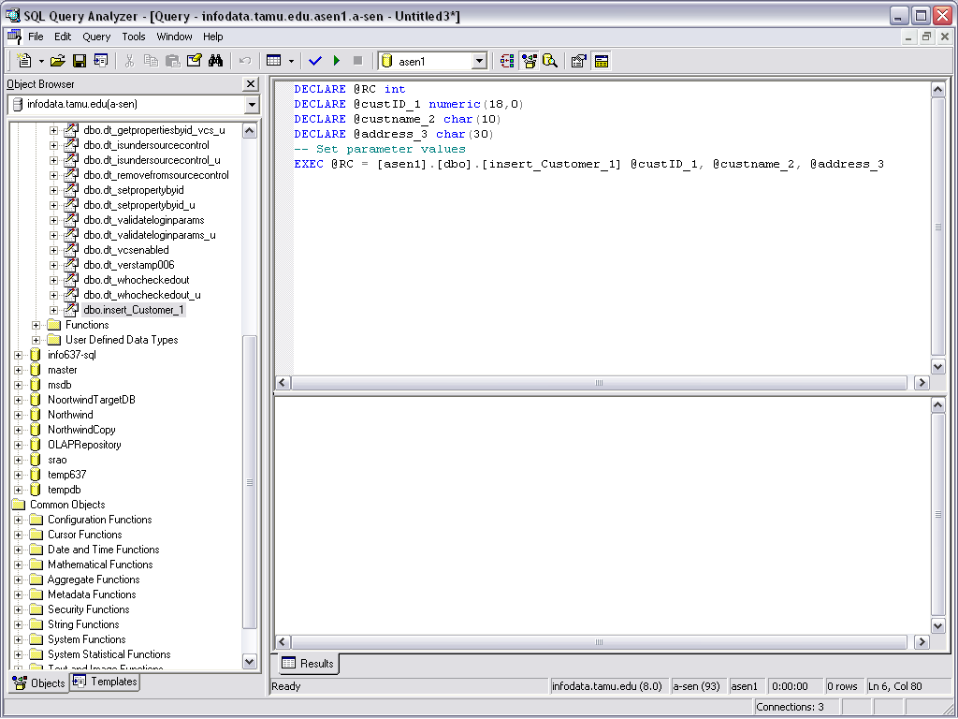
Creating Stored Procedures – Run from QA
8/21/2023
CPYRIGHTED BY ARUN SEN, TAMU
Notes:
You can create stored procedures in Enterprise Manager, but it’s essentially the same as in Query Analyzer.

Slide 66
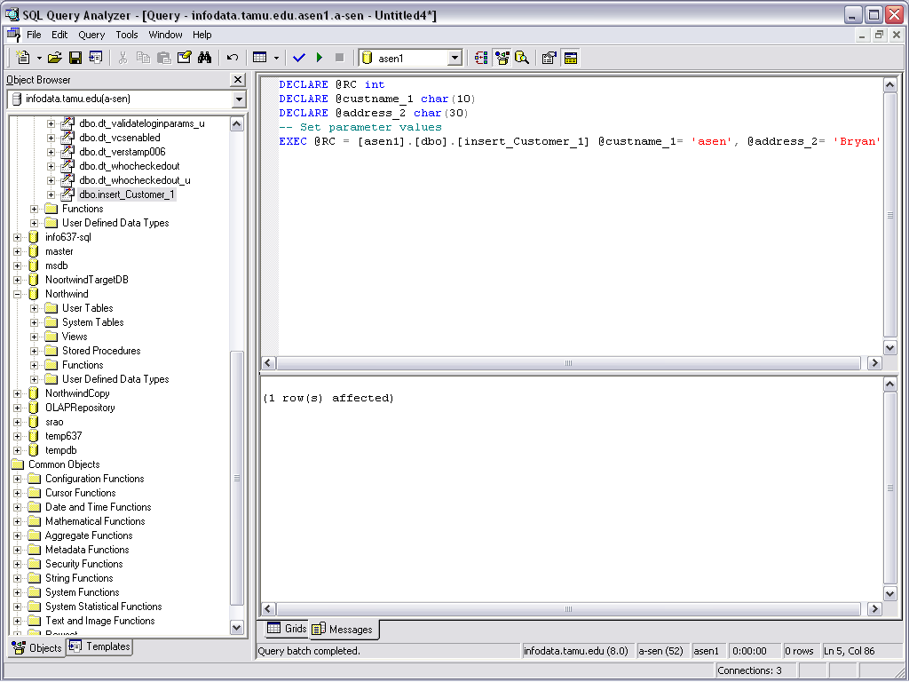
Creating Stored Procedures – Run from QA
8/21/2023
CPYRIGHTED BY ARUN SEN, TAMU
Notes:
You can create stored procedures in Enterprise Manager, but it’s essentially the same as in Query Analyzer.

Slide 67
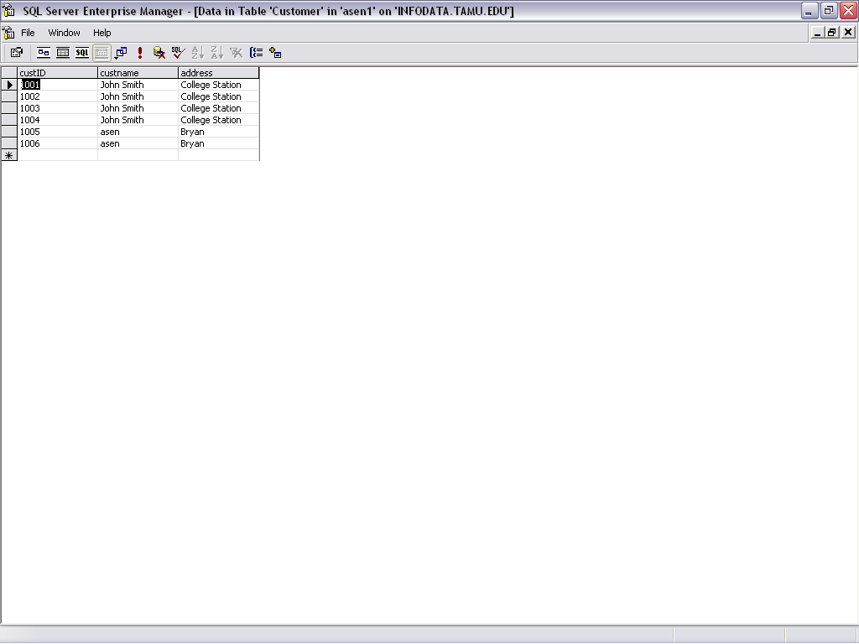
Creating Stored Procedures -- Check in EM
8/21/2023
CPYRIGHTED BY ARUN SEN, TAMU
Notes:
You can create stored procedures in Enterprise Manager, but it’s essentially the same as in Query Analyzer.

Slide 68
Valid Body Statements
CASE statement
FOR statement
GOTO statement
IF statement
ITERATE statement
RETURN statement
WHILE statement
Similar to other programming languages.
8/21/2023
CPYRIGHTED BY ARUN SEN, TAMU

Slide 69
Example Statements
Conditional Statements
  IF <condition> THEN
  <statement(s)>
  ELSE
  <statement(s)>
  END IF;
Loops
  LOOP
  ……
  EXIT WHEN <condition>
  ……
  END LOOP;
8/21/2023
CPYRIGHTED BY ARUN SEN, TAMU

Slide 70
Writing your stored procedures
Different vendors have implementations of stored procedures
As always:
  Start from a sample program. Do not start from scratch!
  “Copy and paste”
8/21/2023
CPYRIGHTED BY ARUN SEN, TAMU

Slide 71
Triggers
6. Triggers
Motivation: enable database programmers to specify
  when to check a constraint,
  what exactly to do.
A trigger has 3 parts:
  An event (e.g., update to an attribute)
  A condition (e.g., a query to check)
  An action (deletion, update, insertion)
  When the event happens, the system will check the constraint, and if satisfied, will perform the action.
  Thus, also called “ECA”
NOTE: triggers may cause cascading effects.
Triggers not part of SQL2 but included in SQL3. DB vendors did not wait for standards with triggers!
8/21/2023
CPYRIGHTED BY ARUN SEN, TAMU

Slide 72
Elements of Triggers (in SQL3)
Timing of action execution: before, after, or instead of triggering event
The action can refer to both the old and new state of the database.
Update events may specify a particular column or set of columns.
A condition is specified with a WHEN clause.
The action can be performed either
  once for every tuple (row-level), or
  once for all the tuples that are changed by the database operation (statement level)
8/21/2023
CPYRIGHTED BY ARUN SEN, TAMU

Slide 73
Row-Level Triggers
emp(name, sal,…)
“No update can reduce employees’ salaries.”
CREATE TRIGGER NoLowerSalary
AFTER UPDATE OF sal ON emp
REFERENCING
OLD AS OldTuple
NEW AS NewTuple
WHEN (OldTuple.sal > NewTuple.sal)
UPDATE Emp
SET sal= OldTuple.sal
WHERE name = NewTuple.name
FOR EACH ROW;
8/21/2023
CPYRIGHTED BY ARUN SEN, TAMU

Slide 74
Statement-Level Triggers
emp(dno…), dept(dept#, …)
“Whenever we insert employees tuples, make sure that their dno’s exist in Dept.”
CREATE TRIGGER deptExistTrig
AFTER INSERT ON emp
REFERENCING
OLD_TABLE AS OldStuff
NEW_TABLE AS NewStuff
WHEN (EXISTS (SELECT * FROM NewStuff
WHERE dno NOT IN
(SELECT dept# FROM dept)))
DELETE FROM emp
WHERE dno NOT IN
(SELECT dept# FROM dept));
8/21/2023
CPYRIGHTED BY ARUN SEN, TAMU

Slide 75
Summary
Key constraints (“primary key” and “unique”)
Foreign-key constraints
Attribute-based checks
Tuple-based checks
Assertions
Triggers
8/21/2023
CPYRIGHTED BY ARUN SEN, TAMU

